Slide 1
Twitter Sentimental Analysis(NLP)| Machine Learning
PROF. SUVARNA RANADE MA’AM
Project Guide
Team members
Tejal Patil
Sumitra Mahadik

Slide 2
Definition:- Natural Language Processing (Computing): This refers to a field of artificial intelligence that focuses on the interaction between computers and humans using natural language. The ultimate objective of NLP is to enable computers to understand, interpret, and generate human language in a way that is both valuable and meaningful. Objective:- The objective of the Twitter Sentiment Analysis project is to analyze tweets and determine the sentiment expressed (positive, negative)to understand public opinion on a particular topic. Significance:- 1. Understanding Public Opinion:- It helps in gauging the sentiments and opinions of Twitter users regarding a particular topic, product, or event. 2.Brand Monitoring:- Companies can use sentiment analysis to monitor how people feel about their brand on Twitter, allowing for quick responses to both positive and negative feedback. 3.Political Analysis:- It's used to analyze public sentiment towards political figures, parties, or issues, providing insights into public opinion. 4.Customer Feedback:- Businesses can analyze tweets to understand customer feedback and improve their products or services based on the sentiments expressed

Slide 3
5.Crisis Management:-It aids in identifying and managing potential PR crises by detecting negative sentiments early and allowing for timely responses.. Dataset Info:- The objective of this task is to detect hate speech in tweets. For the sake of simplicity, we say a tweet contains hate speech if it has a racist or sexist sentiment associated with it. So, the task is to classify racist or sexist tweets from other tweets. Formally, given a training sample of tweets and labels, where label '1' denotes the tweet is racist/sexist and label '0' denotes the tweet is not racist/sexist, your objective is to predict the labels on the test dataset. For training the model we provide a labelled dataset 31,962 tweets . the dataset is provided in the form of csv file with each line providing a tweet id , its label . Row’s in dataset :- 31,962 Column’s in dataset :- 3 (ID , Label , Tweet)

Slide 4
Text Preprocessing:- Text preprocessing is a crucial step in natural language processing (NLP) that involves cleaning and transforming raw text data into a format that can be easily understood and analyzed by machine learning models. The goal of text preprocessing is to enhance the quality of the input data and improve the performance of NLP models. 1) Lowercasing:- Python is case sensitive Language Hence ML Model consider the Similar word of lower case and upper case word as different words Hence we convert all text data to lowercase to ensure uniformity and avoid treating words with different cases as different entities. 2)Removing Punctuation and Special Characters:- Remove non-alphabetic characters, such as punctuation marks and special symbols, unless they convey important information. This helps in simplifying the text and reducing the dimensionality of the data. import re :- Regular expressions(re) are used to define patterns that can match specific sequences of characters in a text Example:- “@[\w]*”

Slide 5
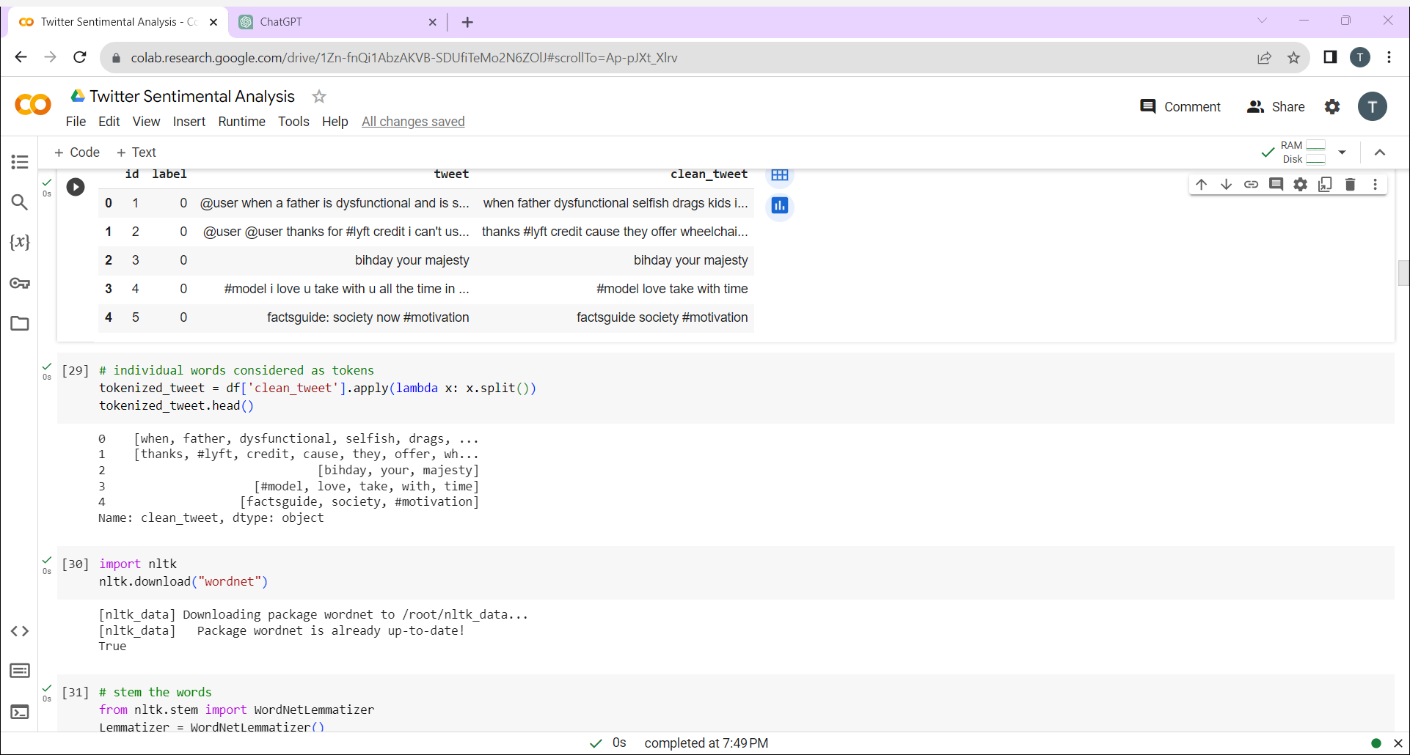
import string To Identify the punctuation marks in text data we used the string Library Example:-!"#$%&\'()*+,-./:;<=>?@[\\]^_`{|}~ 3)Removing Stop Words(Short Words):- Remove common words (stop words) that do not contribute much information to the meaning of the text. Examples include "the," "and," "is," etc. 4) Tokenization:- Break the text into individual words or tokens. Tokenization is a fundamental step in text processing, as it helps in analyzing the structure of the text Techniques:- Split function , Regular Expression Tokenization

Slide 6
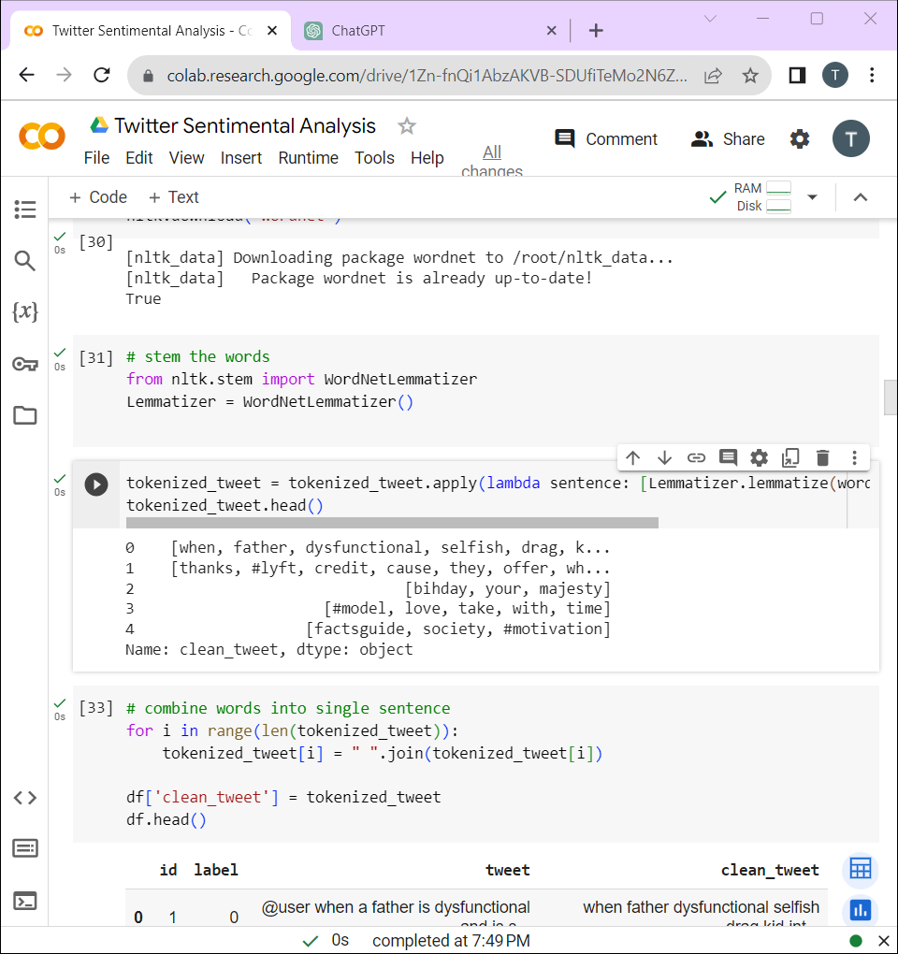
5) Stemming and Lemmatization:- Reduce words to their root form to normalize variations. Stemming involves removing suffixes, while lemmatization involves reducing words to their base or dictionary form. This helps in reducing the dimensionality of the feature space. Lemmatization:- Lemmatization helps standardize words to their base form, ensuring consistency in the representation of similar words. For example, "running" and "ran" would both be lemmatized to "run.“ import nltk from nltk.stem import WordNetLemmatizer

Slide 7
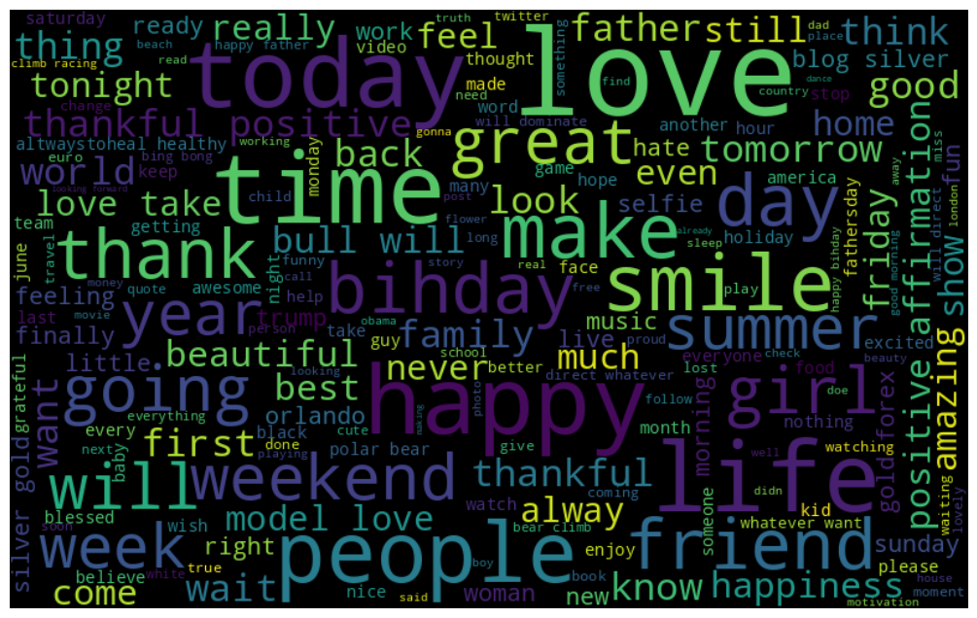
Exploratory data Analysis:- Exploratory Data Analysis (EDA) is a critical step in the data analysis process that involves summarizing the main characteristics of a dataset, often with the help of graphical representations. EDA helps analysts and data scientists understand the structure and content of the data, identify patterns, and gain insights into the relationships between variables. 1) Data Visualization:- # visualize the frequent words Word Clouds: Word clouds visually represent the most frequent words in a text corpus. The size of each word is proportional to its frequency. This type of visualization provides a quick overview of the most prominent terms. Libraries:- import matplotlib.pyplot as plt import seaborn as sns from wordcloud import WordCloud

Slide 8
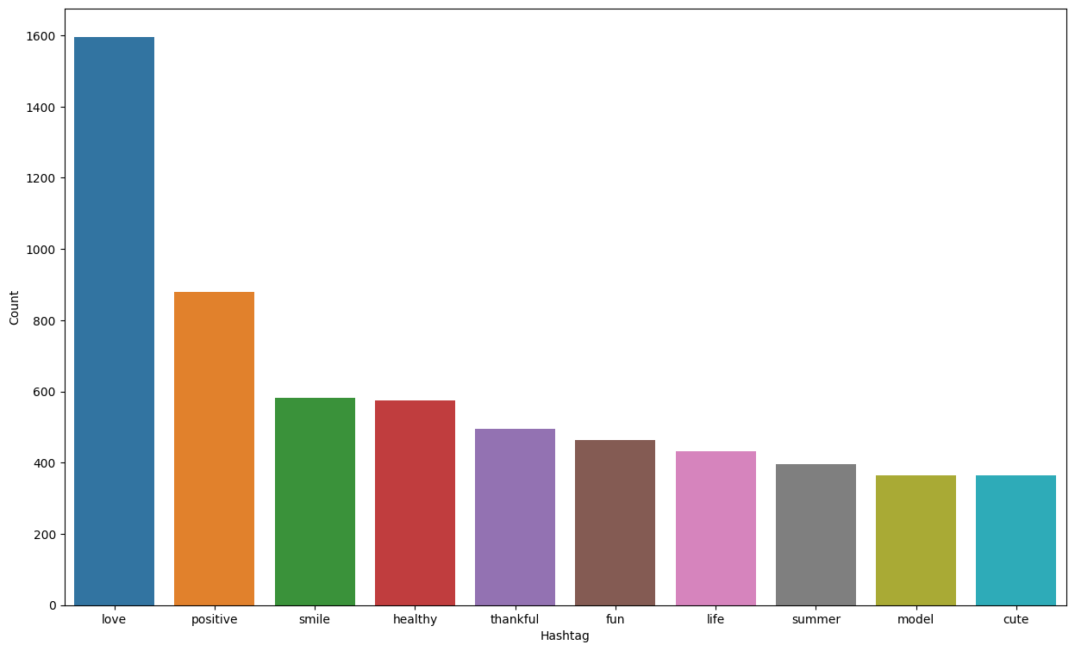
# Frequent words visualization for +ve:- Positive sentiment analysis refers to the process of determining and analyzing positive sentiments expressed in text data. text analysis that focuses on understanding and identifying positive emotions, opinions, or attitudes conveyed in written or spoken language.

Slide 9
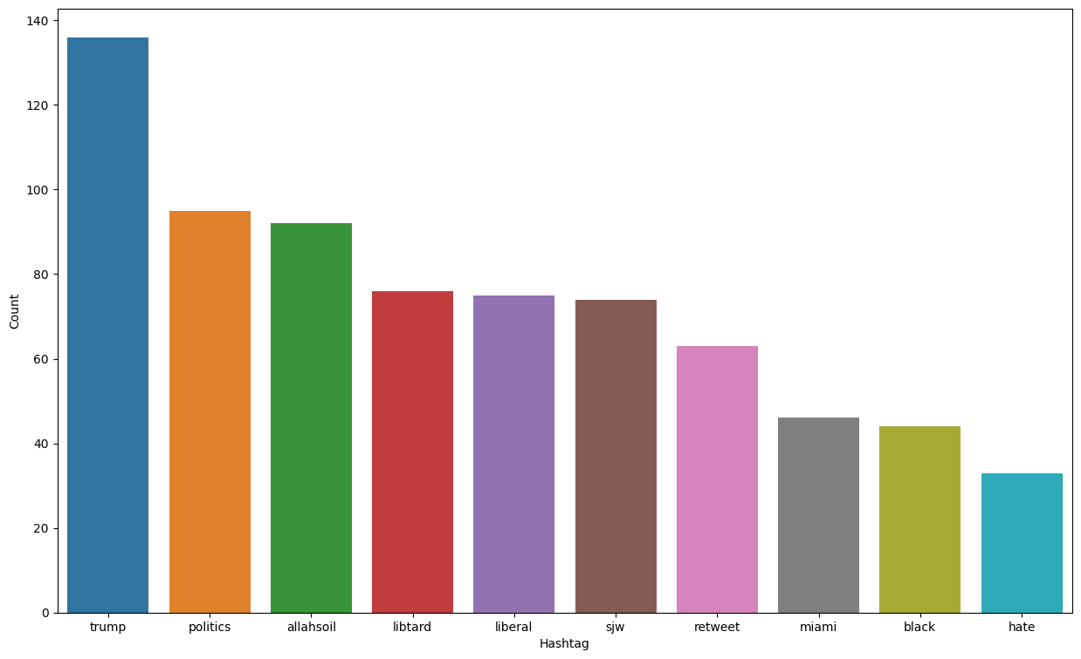
#Frequent words visualization for –ve:- Negative sentiment analysis involves determining the negative emotions, opinions, or sentiments expressed in a given text or dataset. The goal is to understand and identify the aspects of the text that convey dissatisfaction, criticism, or negative feedback.

Slide 10
2)Feature Extraction:- Feature extraction in Natural Language Processing (NLP) involves converting raw text data into a format that can be used by machine learning models. Bag-of-Words (BoW):- Represents a document as an unordered set of words. Each word in the document is treated as a separate feature, and the frequency of each word is used as its value. Disregards word order and context. Library:- from sklearn.feature_extraction.textimport CountVectorizer
CountVectorizer is a feature extraction technique used in Natural Language Processing (NLP) for converting a collection of text documents to a matrix of token counts. This process involves representing a document as an unordered set of words, disregarding grammar and word order, and focusing on the frequency of each word.

Slide 11
Input Split:- 1)Train-Test Split:-
In machine learning, it's common to split the dataset into training and testing sets. The training set is used to train the model, and the testing set is used to evaluate its performance on unseen data. The train_test_split function from libraries like scikit-learn is often used for this purpose. Library:- from sklearn.model_selection import train_test_split 2) Cross-validation:- Cross-validation involves dividing the dataset into multiple folds and using each fold as a testing set while the mode is trained on the remaining folds. It helps to get a more robust estimate of the model’s performance 3)GridSearchCV:- This technique is used to tune hyperparameters for a machine learning model. It systematically searches through a specified hyperparameter grid, evaluates the model performance using cross validation, and identifies the combination of parameters that yields the best performance.

Slide 12
Libraries:- from sklearn.metrics import classification_report from sklearn.metrics import confusion_matrix, accuracy_score, roc_auc_score, roc_curve from sklearn.model_selection import GridSearchCV When testing the performance of a machine learning model, there are various metrics and parameters that can be considered depending on the type of problem (classification, regression, etc.) and the specific goals of the analysis. Accuracy: The ratio of correctly predicted instances to the total instances. It's a common metric for balanced datasets. Precision: The ratio of correctly predicted positive observations to the total predicted positives. Precision focuses on the accuracy of the positive predictions. Recall (Sensitivity or True Positive Rate): The ratio of correctly predicted positive observations to the all observations in the actual class. Recall focuses on the ability of the model to capture all the positives.

Slide 13
F1 Score: The harmonic mean of precision and recall. It provides a balance between precision and recall. Confusion Matrix: A table that summarizes the performance of a classification algorithm, showing the number of true positives, true negatives, false positives, and false negatives. Model building:-Model building typically refers to the process of creating and training a machine learning model to make predictions or perform a specific task. both training data accuracy and test data accuracy are important metrics in evaluating the performance of a machine learning model. Training Data Accuracy: Training accuracy measures how well the model performs on the data it was trained on. It indicates how effectively the model has learned the patterns and relationships within the training set. Test Data Accuracy: Test accuracy evaluates the model's performance on data it has never seen during training. It provides an estimate of how well the model can generalize to new, unseen examples.

Slide 14
A large gap between training and test accuracy may indicate overfitting, suggesting that the model has not generalized well beyond the training data. Overfitting: If the model performs well on the training set but poorly on the test set, it might be overfitting. Underfitting: If both training and test accuracies are low, the model may be underfitting. This suggests that the model is too simple to capture the underlying patterns in the data, and you may need a more complex model. Balancing Accuracy with Other Metrics: While accuracy is a common metric, depending on the problem, other metrics like precision, recall, F1 score, or area under the ROC curve (AUC-ROC) may be more appropriate. The choice depends on the specific goals and characteristics of your problem.

Slide 15
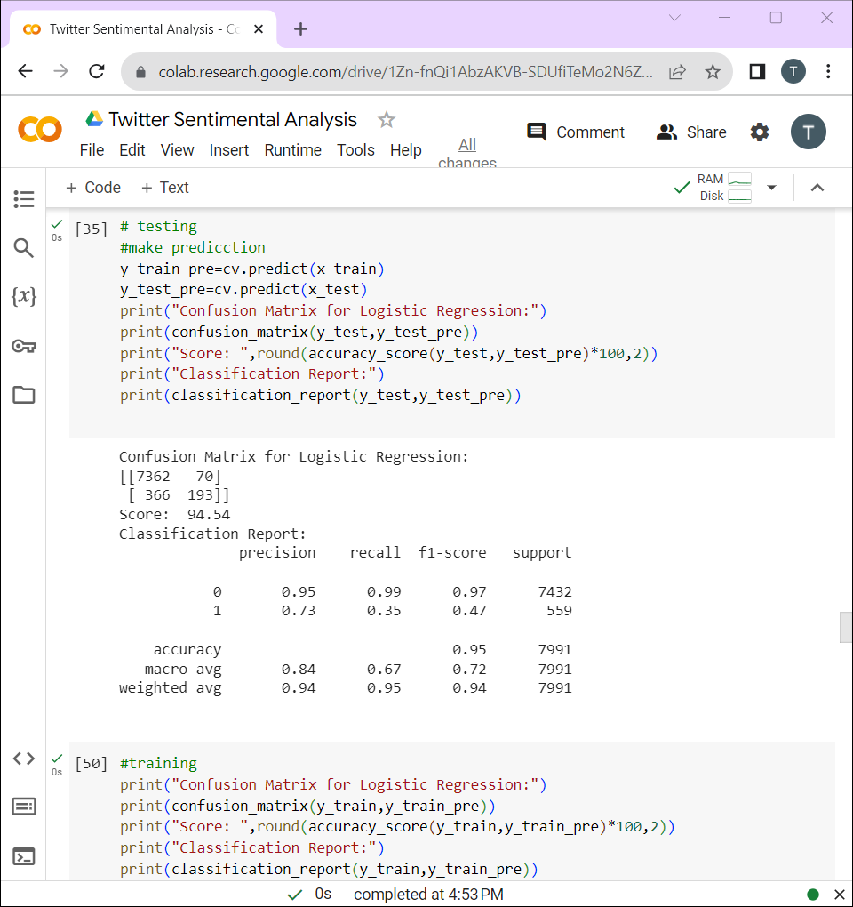
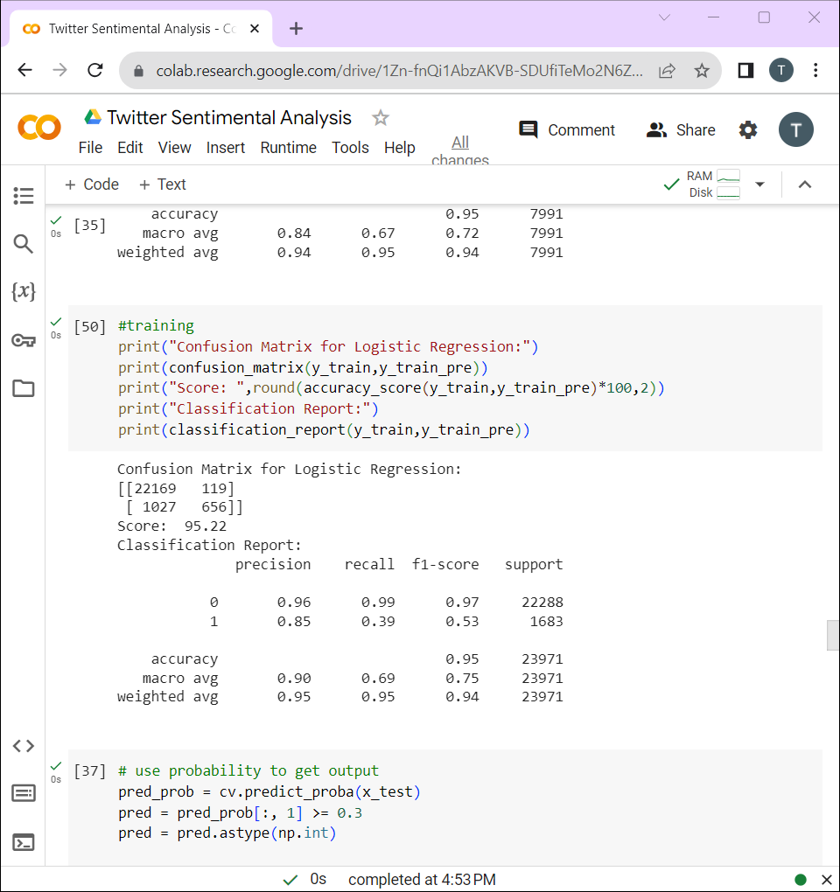
Logistic regression:-Logistic Regression is primarily used for binary classification problems, where the target variable has two possible outcomes (e.g., 0 or 1, True or False). Logistic Regression is computationally efficient and can be trained quickly on large datasets. It is less prone to overfitting compared to more complex models, making it a good choice when computational resources are limited or when a simpler model is sufficient. from sklearn.linear_model import LogisticRegression # For Testing Data # For Training Data

Slide 16
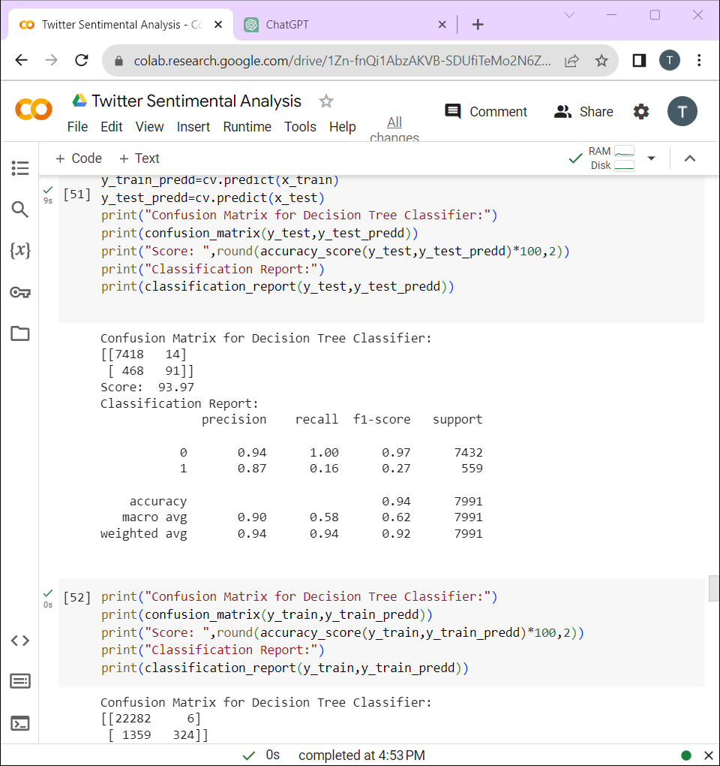
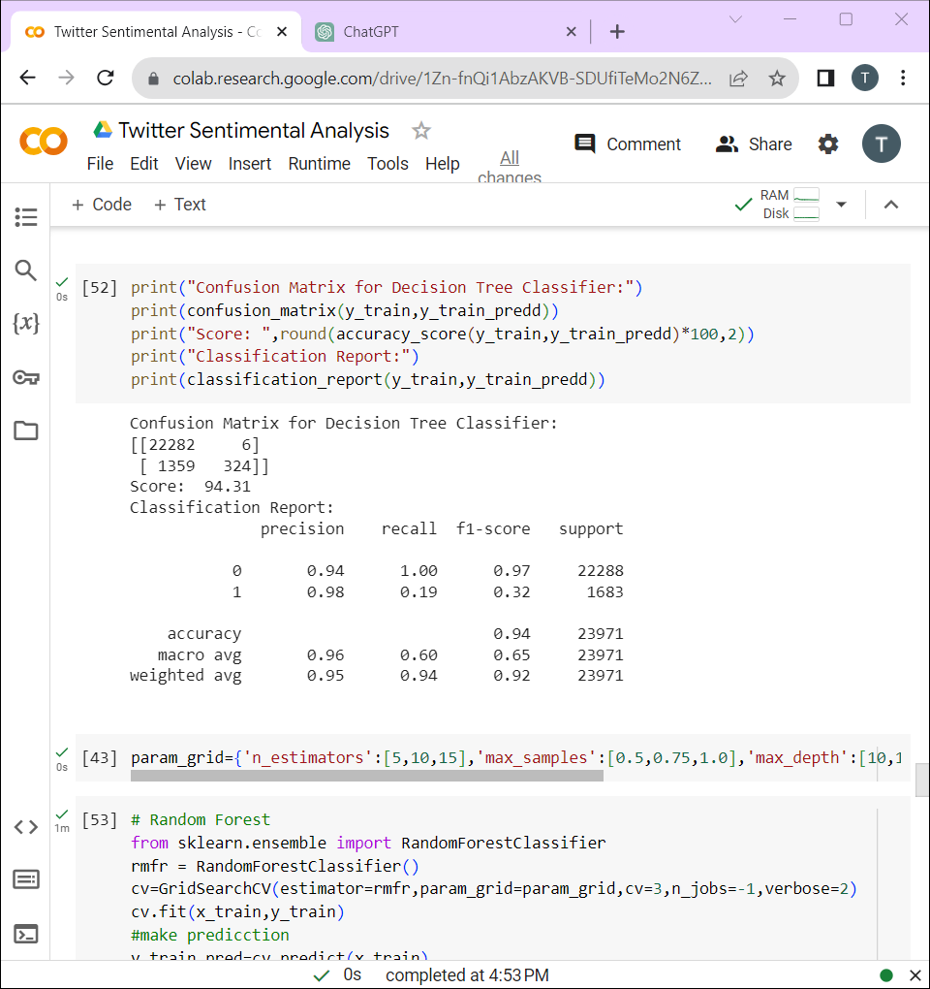
Decision tree:- This can help in identifying the most relevant words or features that drive sentiment predictions. from sklearn.tree import DecisionTreeClassifier # For Testing Data # For Training Data

Slide 17
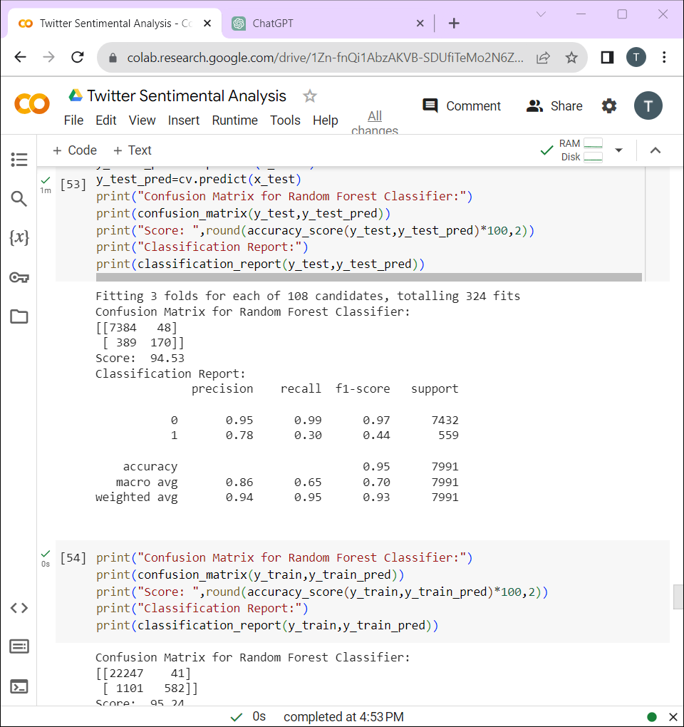
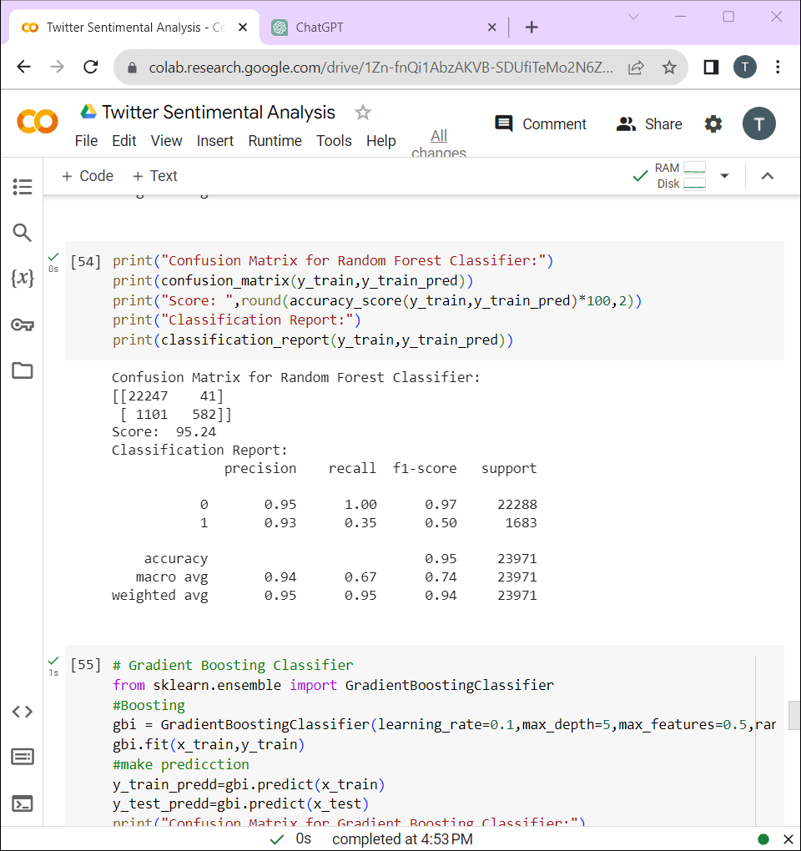
Random Forest Classifier:-Decision trees are prone to overfitting, capturing noise and specific patterns in the training data that may not generalize well to new, unseen data. Random Forest mitigates overfitting by building multiple trees on different subsets of the data (bootstrap samples) and aggregating their predictions. from sklearn.ensemble import RandomForestClassifier # For Testing Data # For Training Data

Slide 18
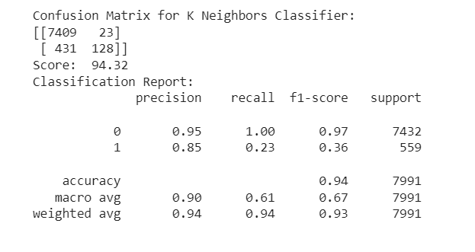
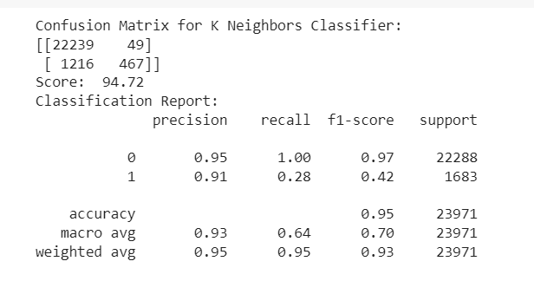
K Nearest Neighbour Classifier:- >k-NN is a simple and versatile supervised machine learning algorithm used for classification and regression tasks. It classifies or predicts the label of a data point by considering the majority class or average of its k-nearest neighbors in the feature space >Apply the k-NN algorithm to the training set. The model learns patterns based on the feature vectors of customers and their corresponding churn labels. >Use the trained k-NN model to predict churn for the test set. The model calculates distances to find the nearest neighbors and predicts the class based on majority voting from sklearn.neighbors import KNeighborsClassifier # For Testing Data # For Training Data

Slide 19
Interpretation:- For choosing the best model ,we have to consider training data accuracy as well as test data accuracy , Here all the models that we have fitted gives good training as well as testing accuracy that means all the models captures training data well and predicts the accurate output for the test data. Here, We chose Random forest as the best fitted model , because It has high accuracy also here we have to consider the confusion matrix which has minimum False Positive classification. Accuracy for best fitted model – Random forest – 95.24

